Slide 1
IONIC + Firebase S-CRUD
Insert Record
SLIDES/NOTES
Bit.ly/ionickerul

Slide 2
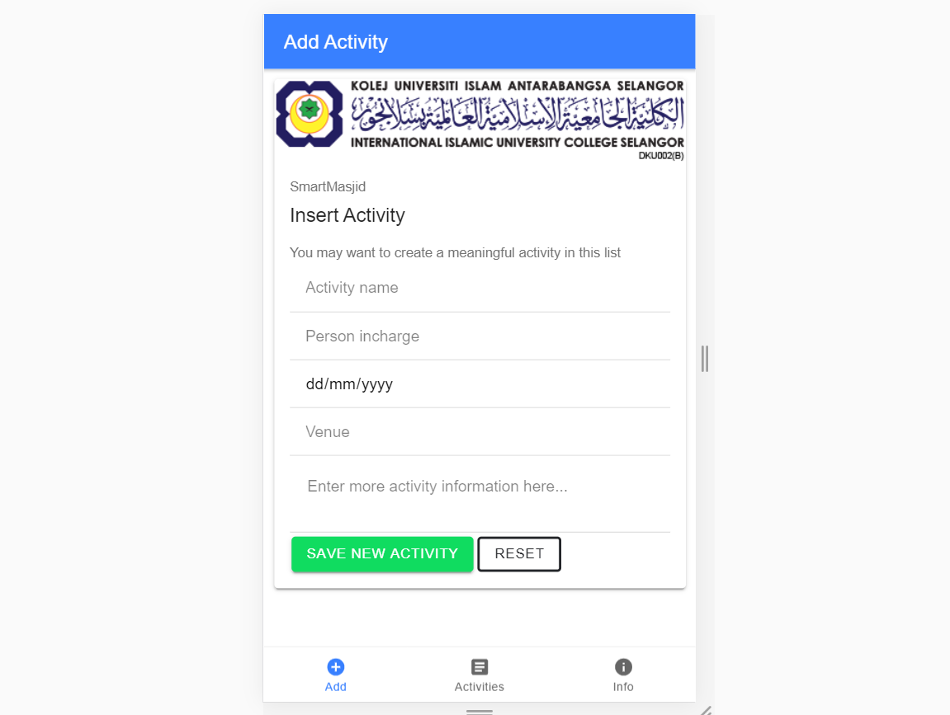
OVERVIEW

Slide 3
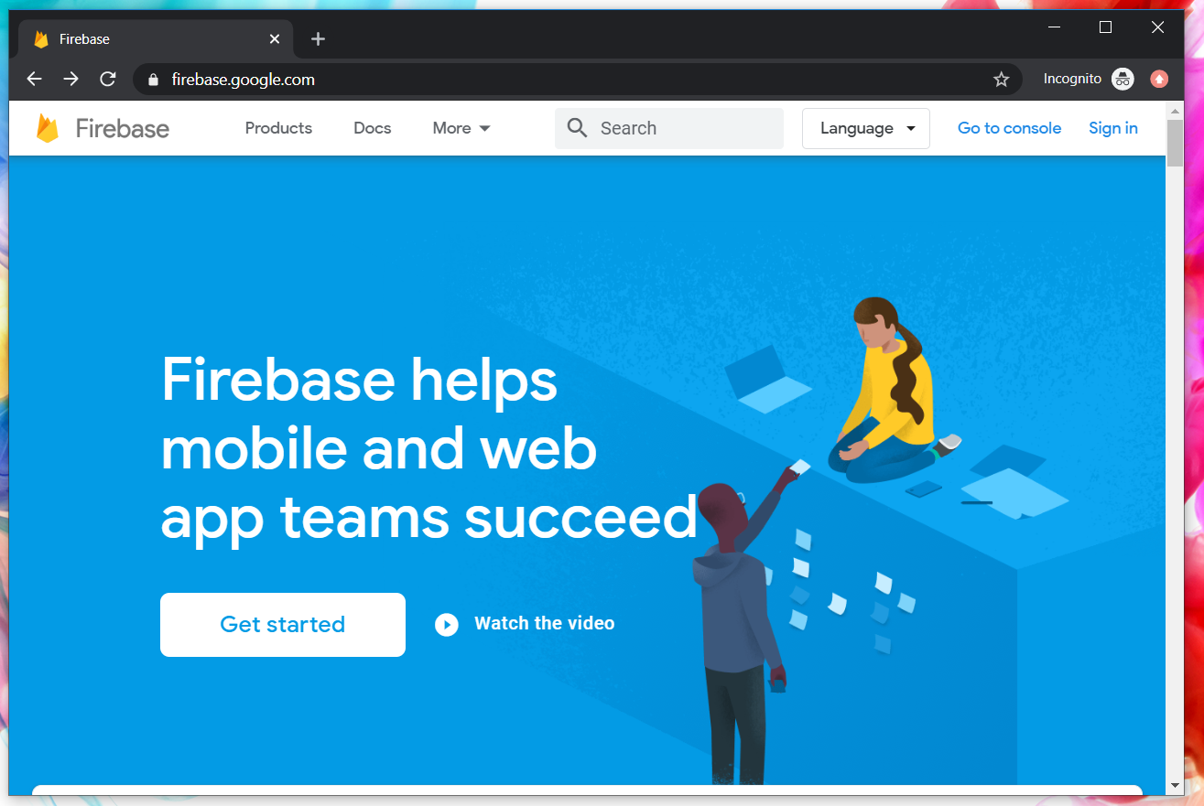
Google Firebase : Console
https://console.firebase.google.com/

Slide 4
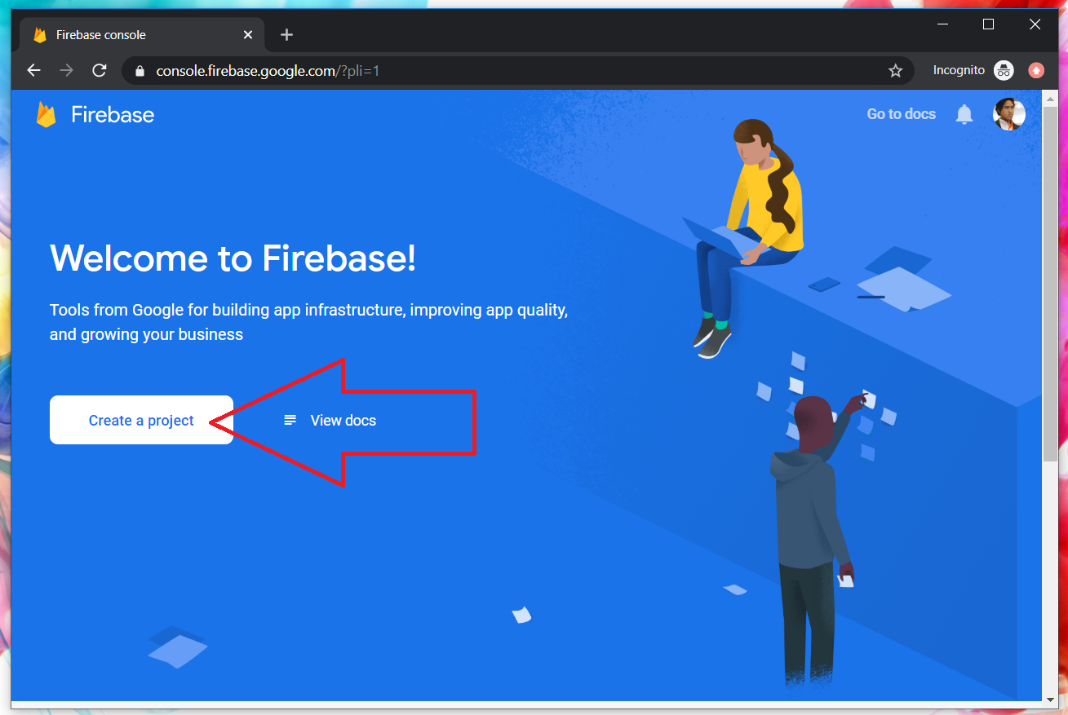
Google Firebase : Create new project

Slide 5
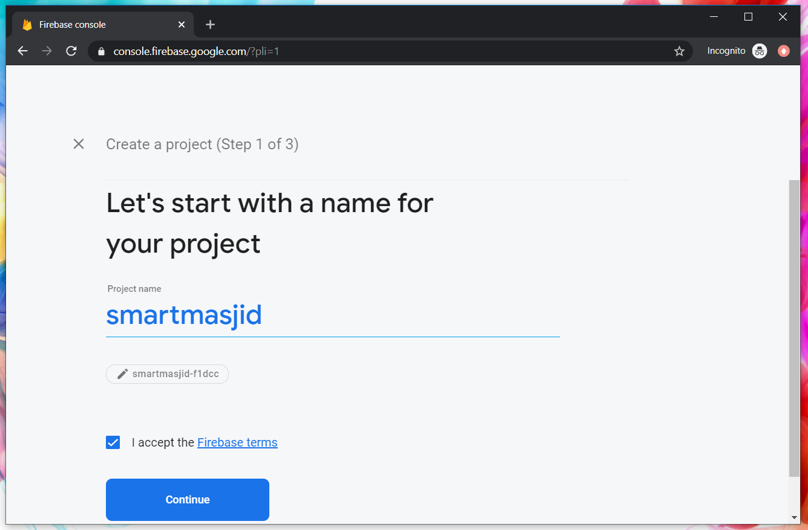
Google Firebase : Project name

Slide 6
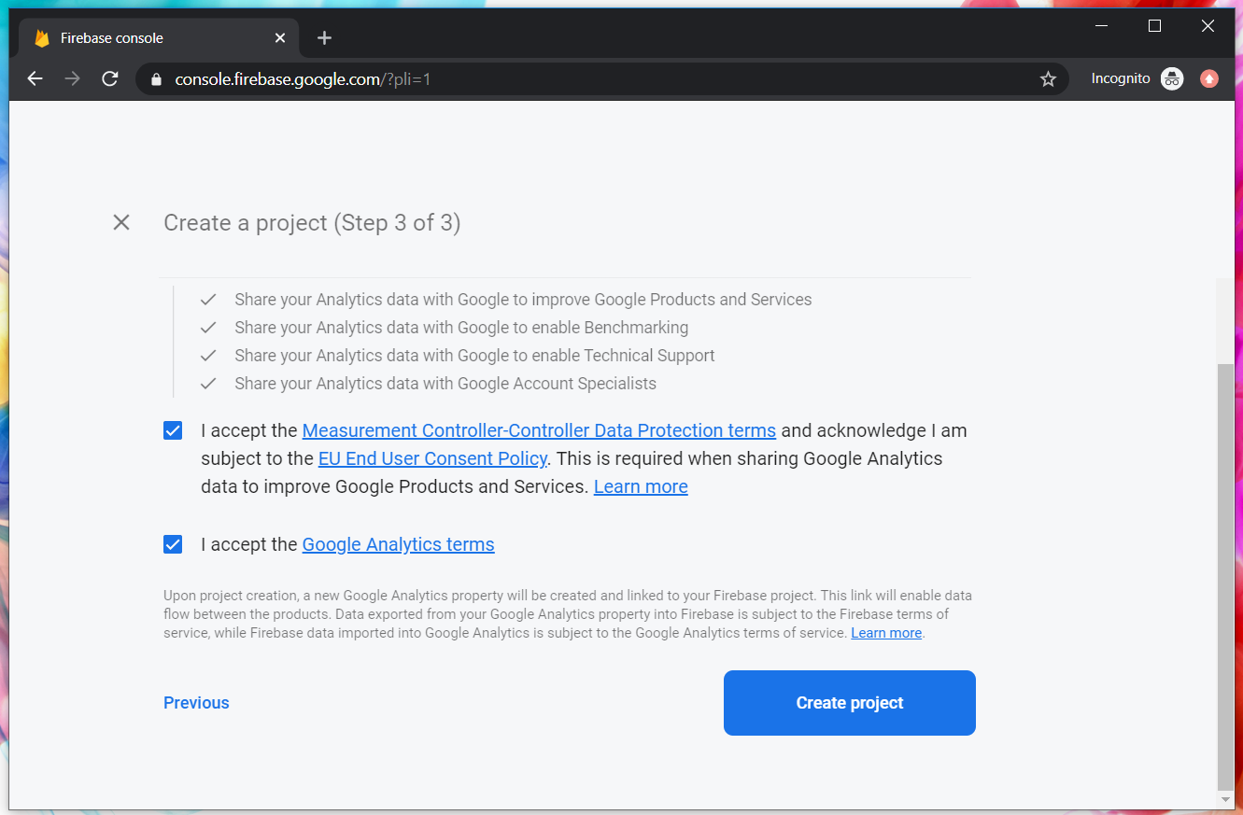
Google Firebase : Accept T&C

Slide 7
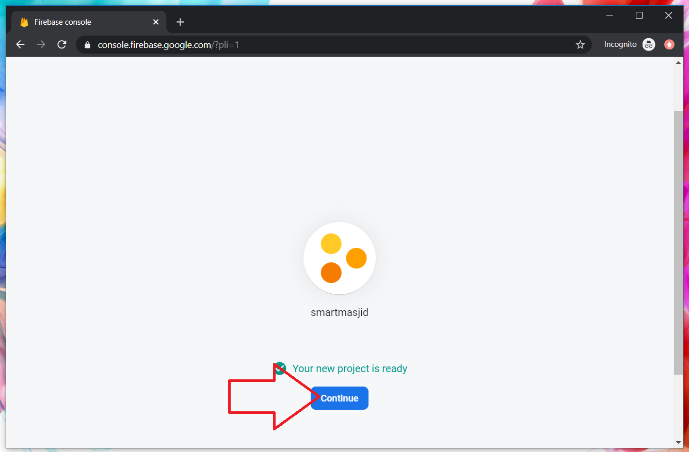
Google Firebase : Project ready and continue

Slide 8
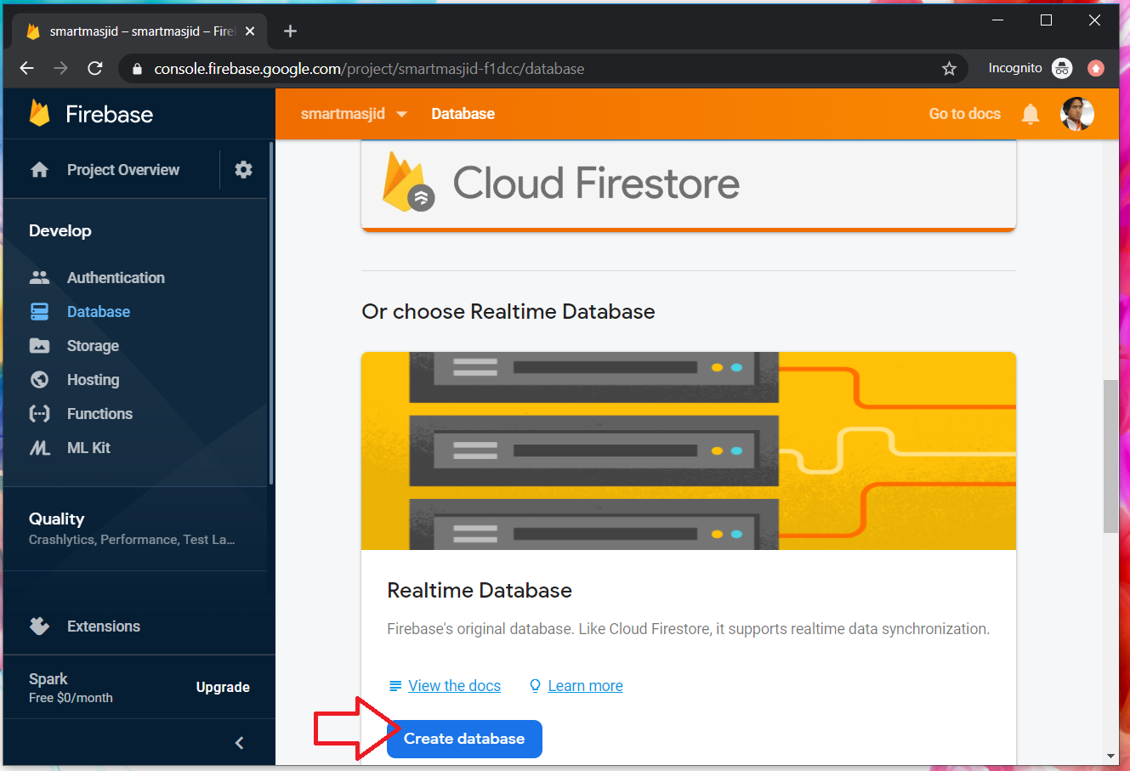
Google Firebase : Realtime database

Slide 9
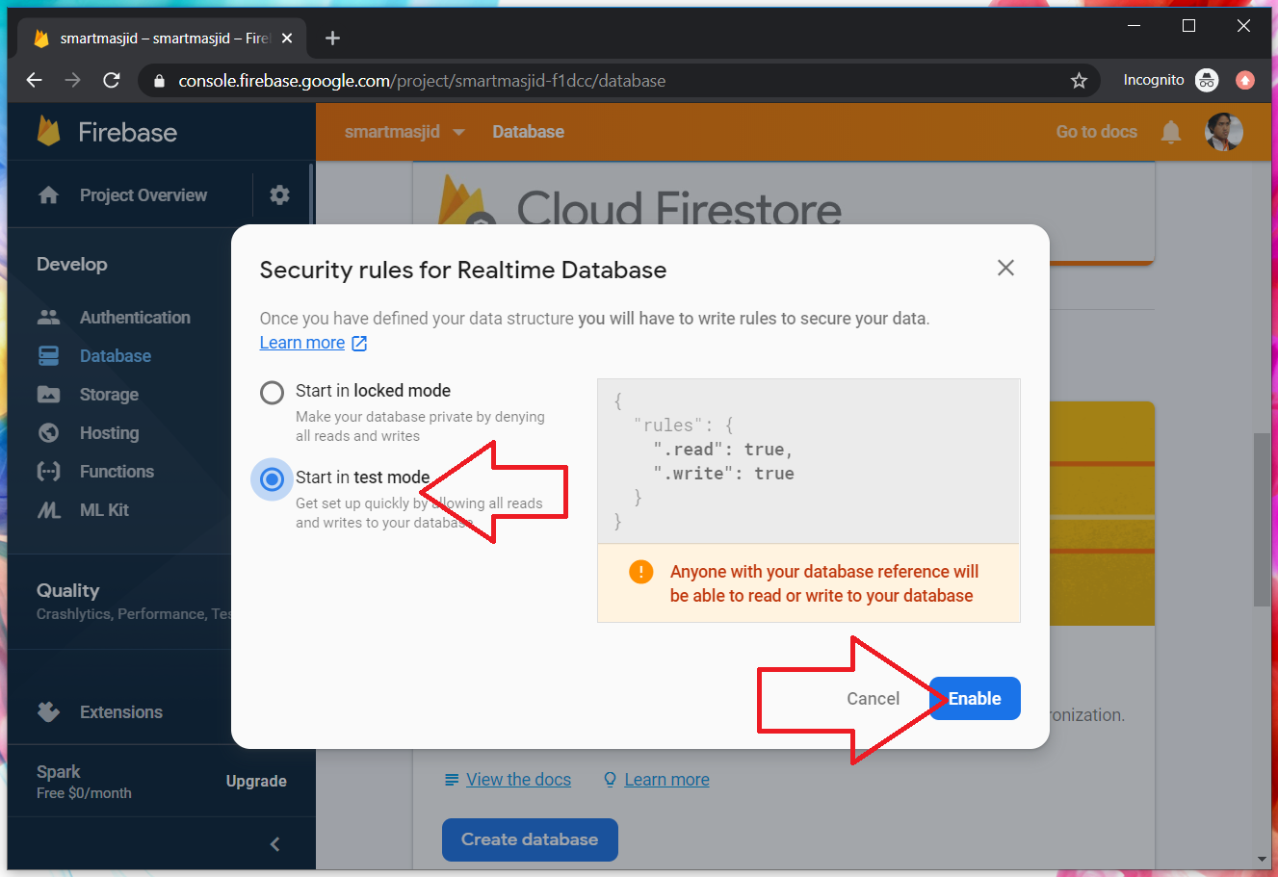
Google Firebase : Enable test mode

Slide 10
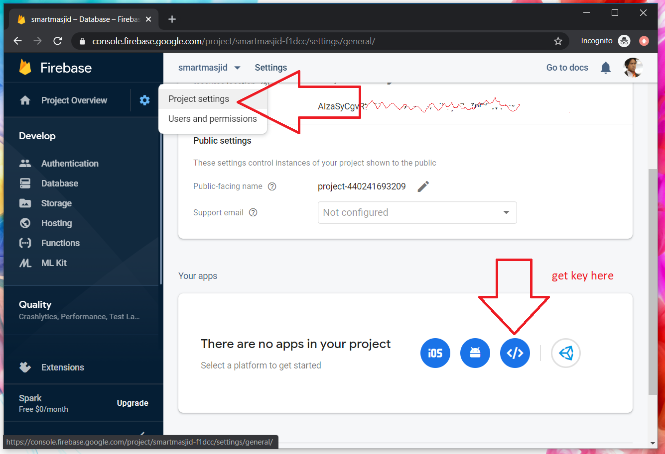
Google Firebase : get key

Slide 11
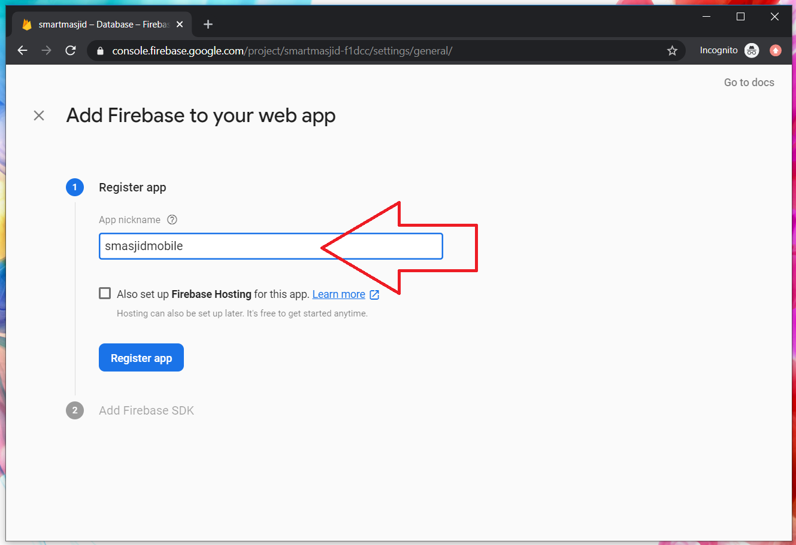
Google Firebase : project nickname

Slide 12
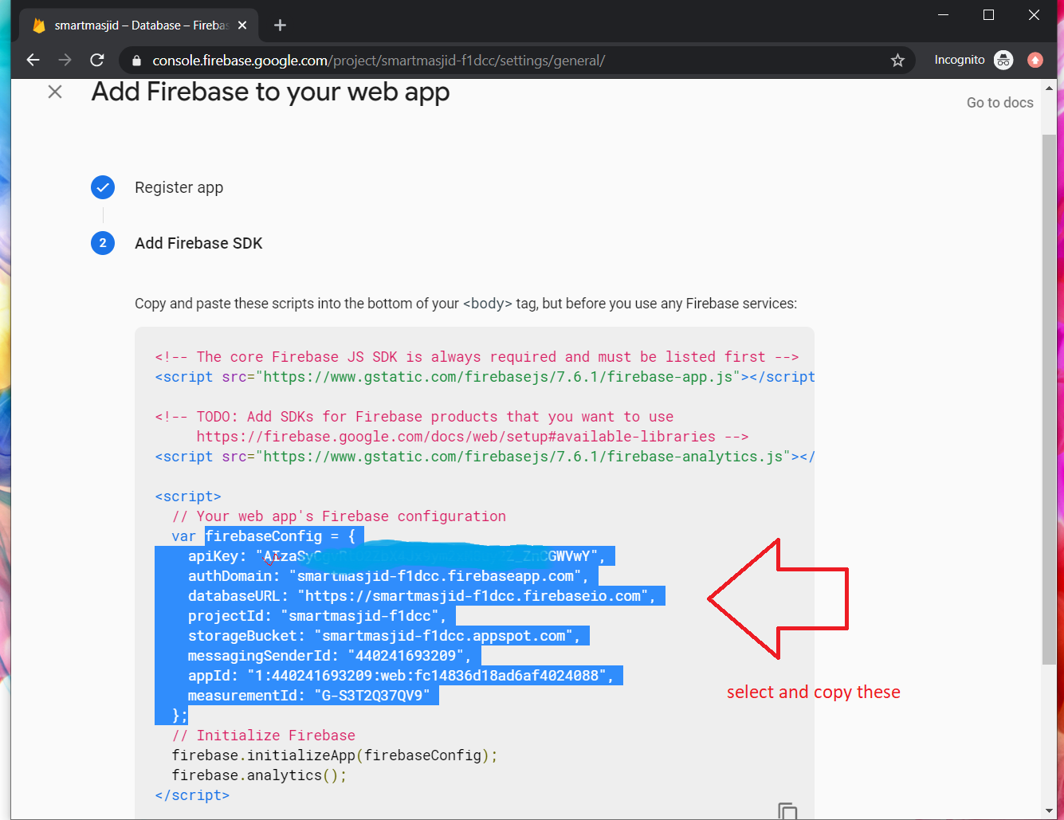
Google Firebase : select copy Firebase security token

Slide 13
IONIC : Create new Ionic project with Tabs
D:\>npm install -g ionic cordova
D:\>ionic start ionmasjid tabs
D:\ionmasjid>npm install firebase @angular/fire
D:\ionmasjid>ionic g service service/firebase

Slide 14
IONIC : environment.ts
Provide the Google Firebase token in environment.ts

Slide 15
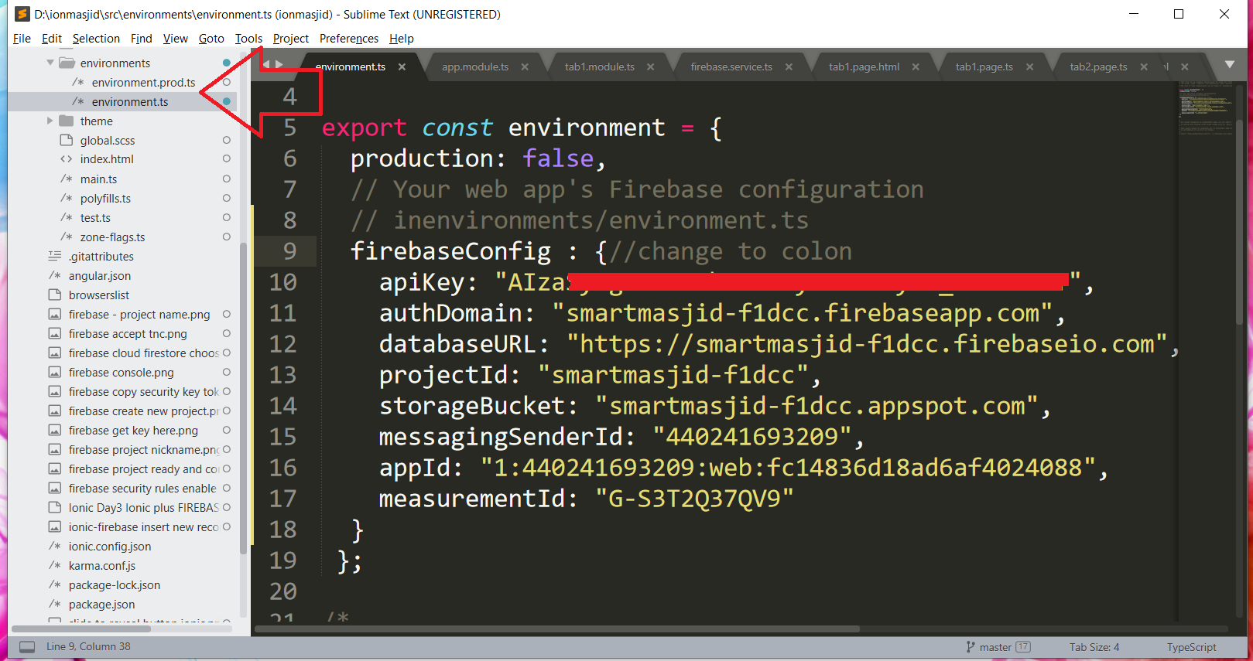
IONIC : environment.ts

Slide 16
IONIC : app.module.ts
Provide the Google Firebase additional module in app.module.ts

Slide 17
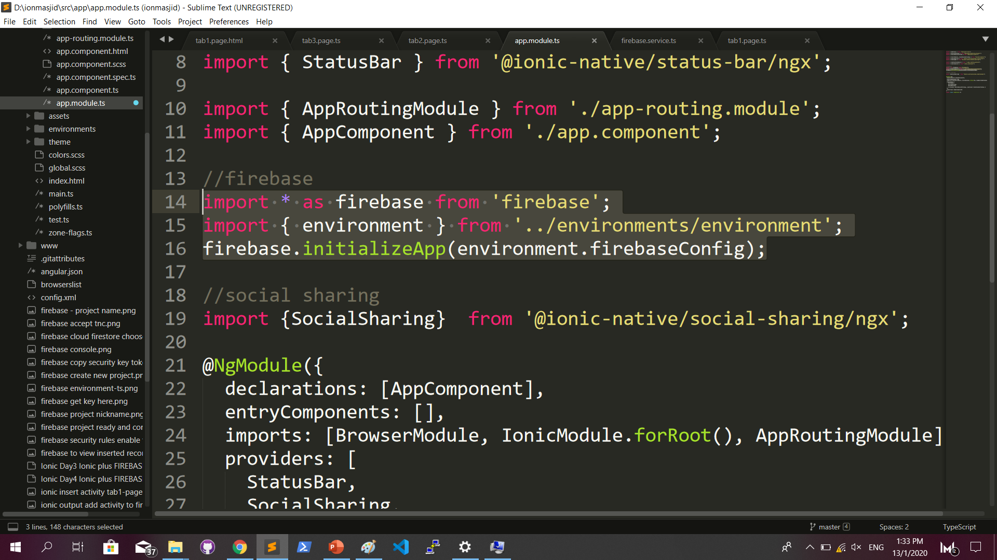
IONIC : app.module.ts

Slide 18
IONIC : service/firebase.ts
Insert record process to Firebase in service

Slide 19
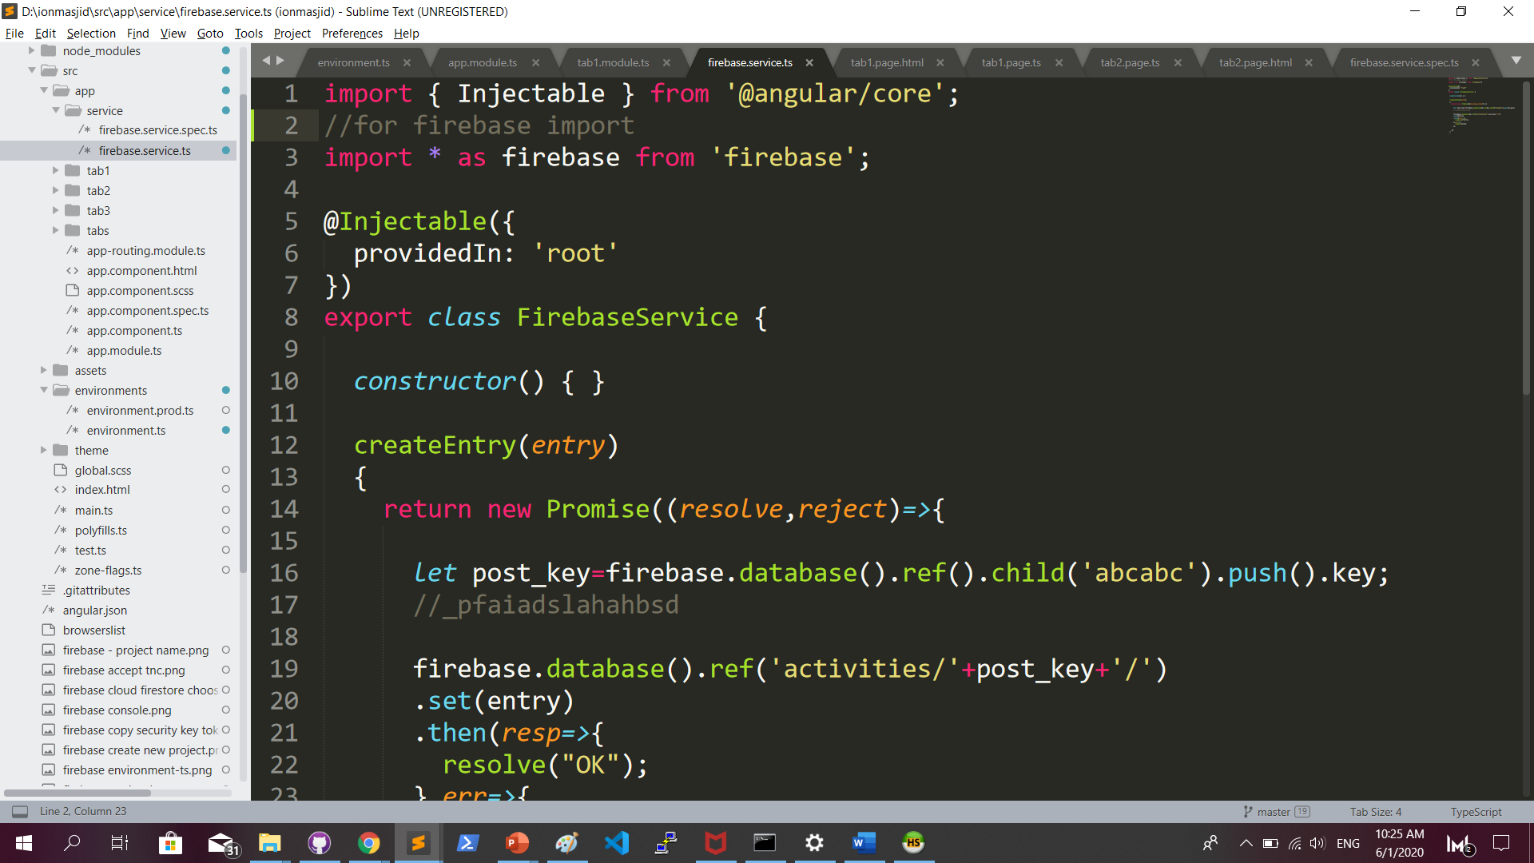
IONIC : service/firebase.ts

Slide 20
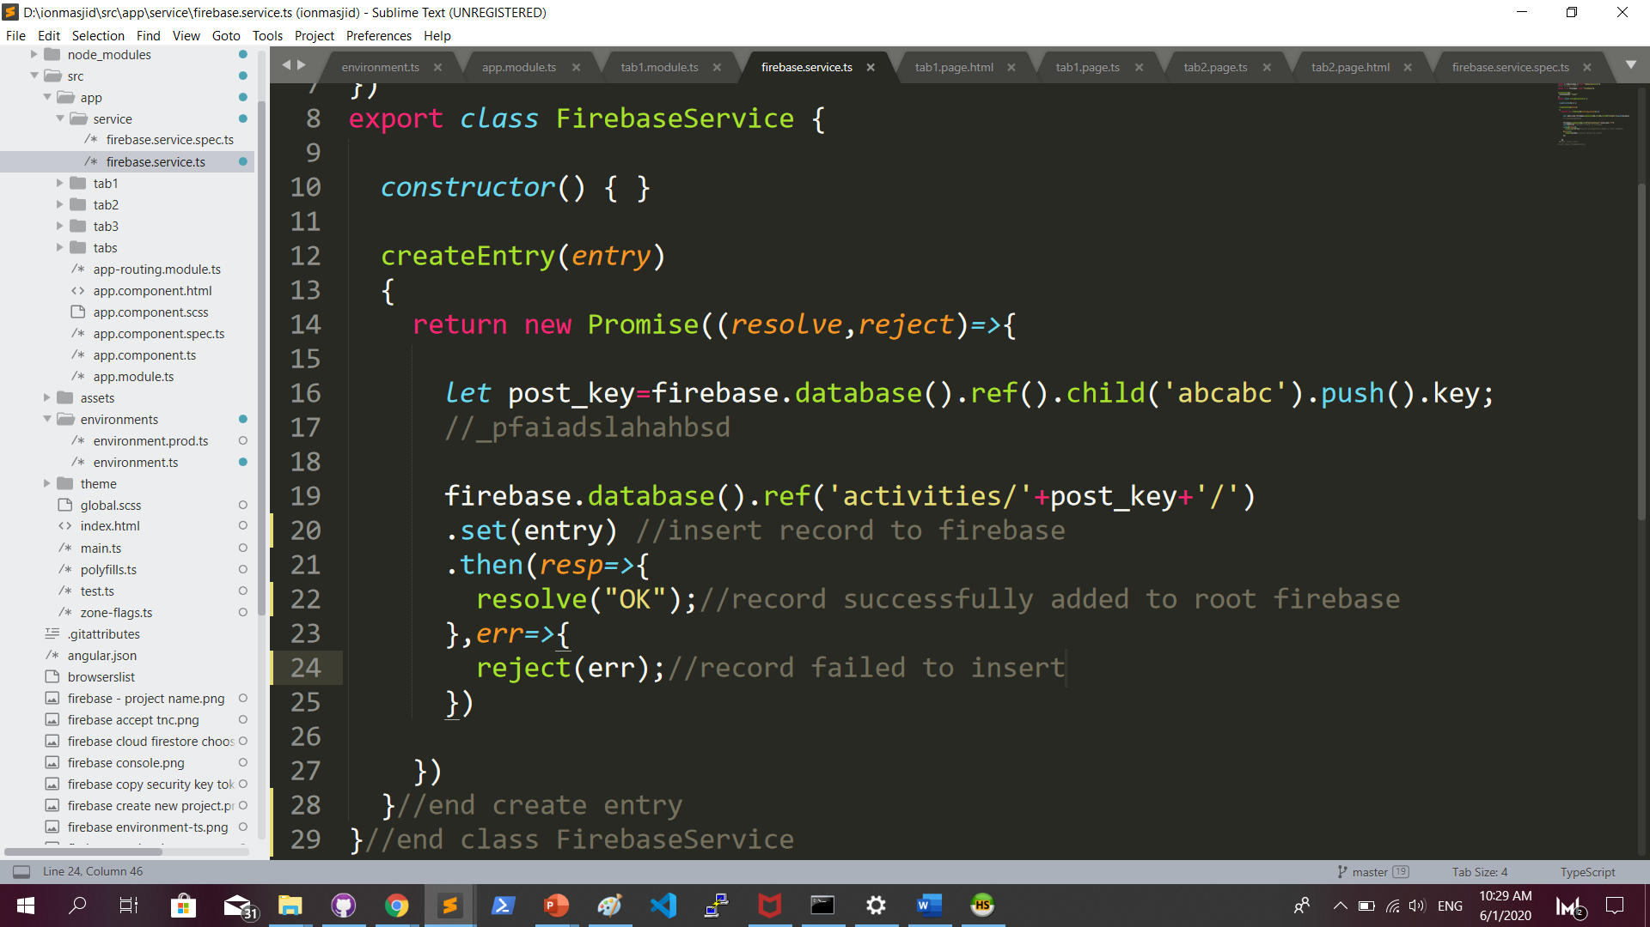
IONIC : service/firebase.ts add function createEntry

Slide 21
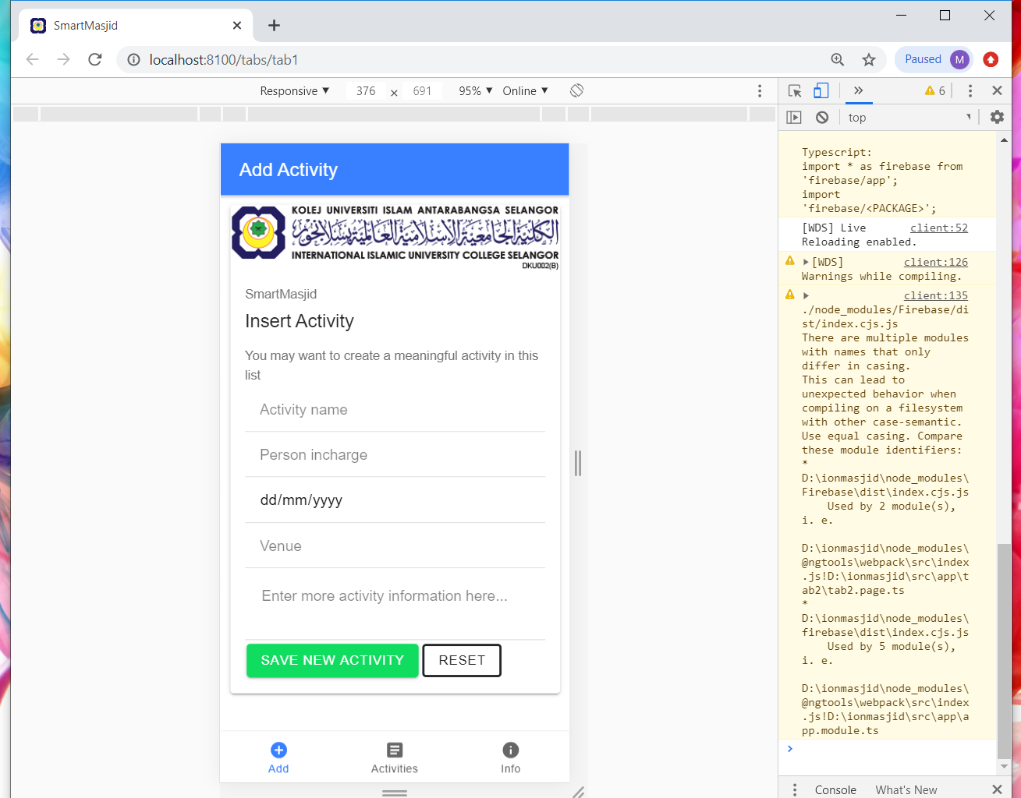
IONIC : tab1.page.html

Slide 22
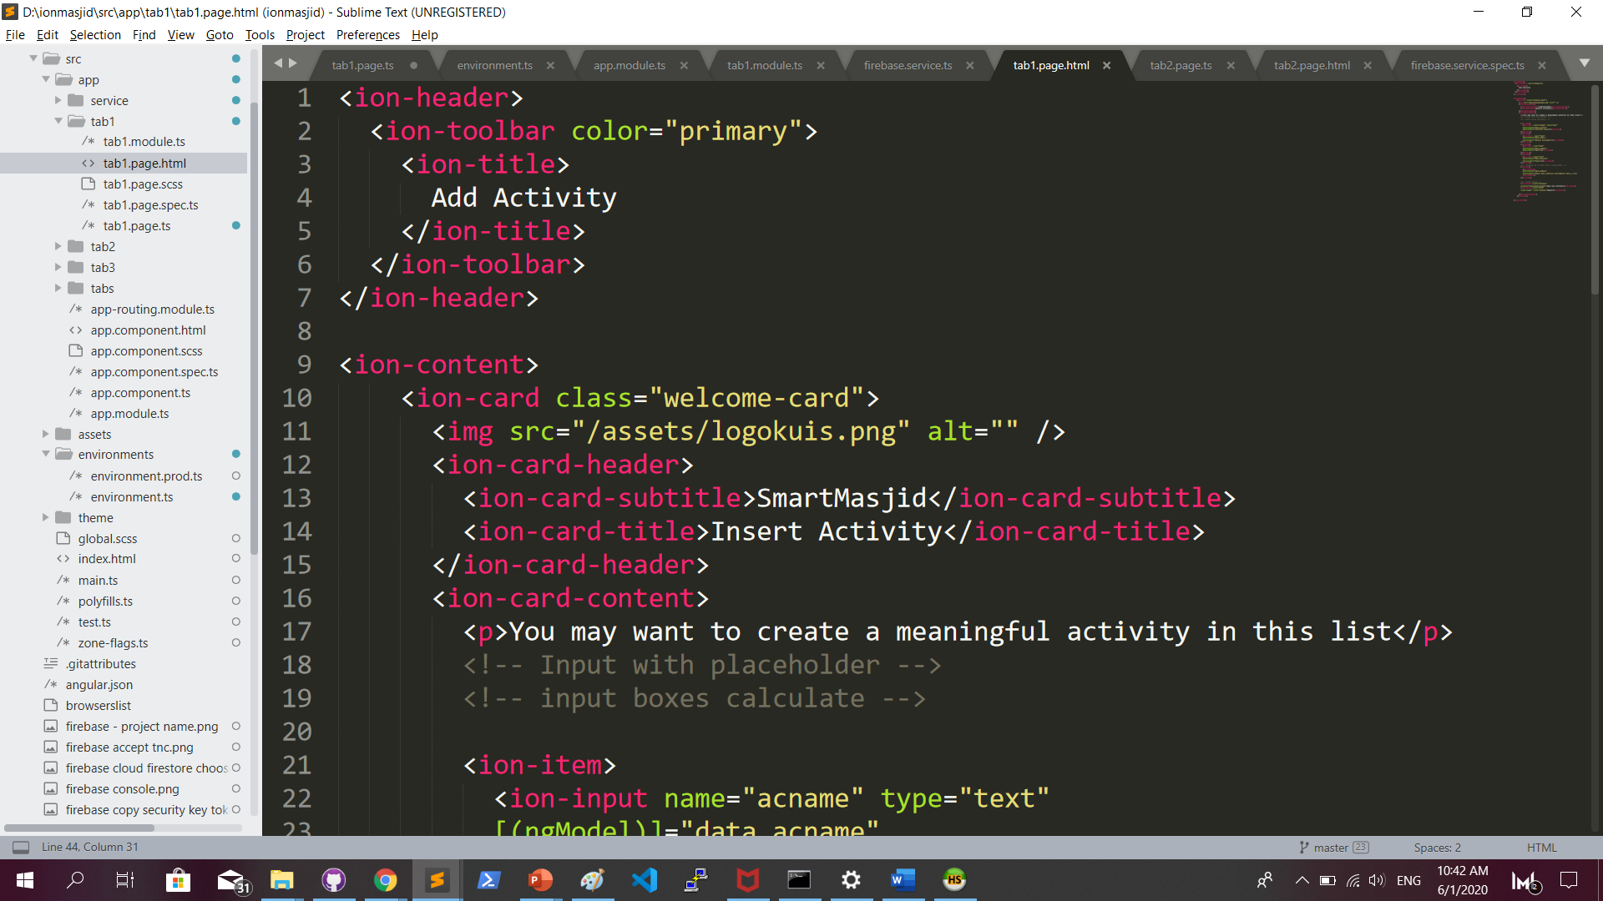
IONIC : tab1.page.html

Slide 23
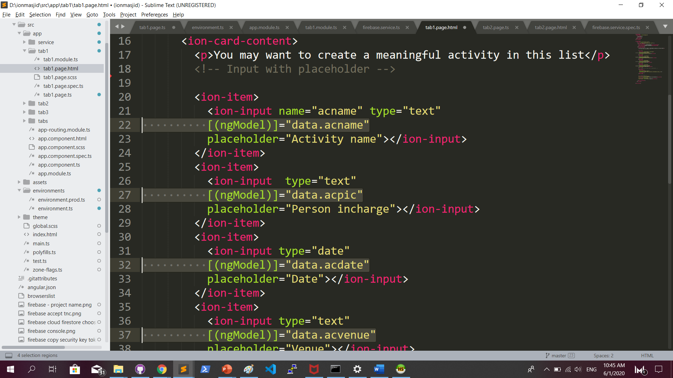
IONIC : tab1.page.html [(ngModel)]

Slide 24
IONIC : tab1.page.ts
Capture record data from ngModel input, and send to FirebaseService

Slide 25
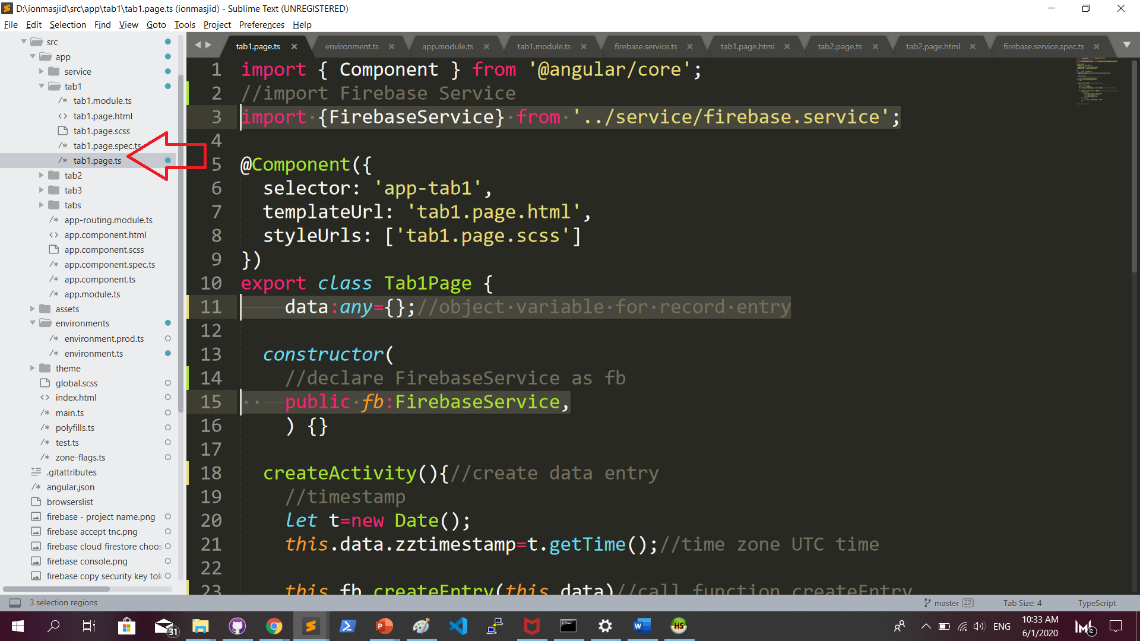
IONIC : tab1.page.ts

Slide 26
IONIC : tab1.page.ts
createActivity function to send record to FirebaseService

Slide 27
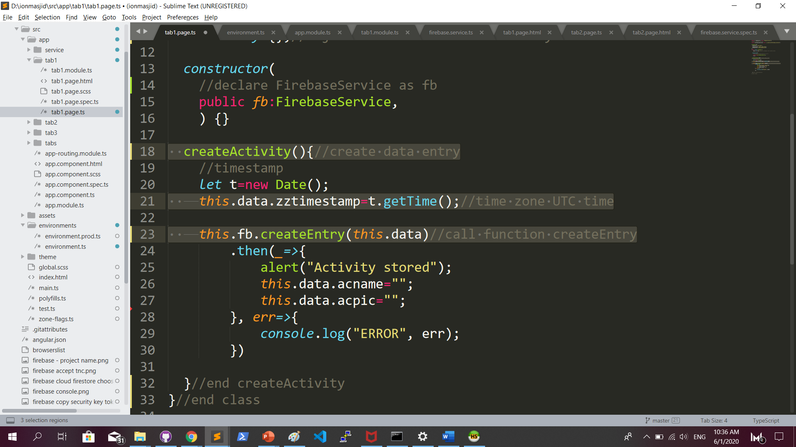
IONIC : tab1.page.ts …continued

Slide 28
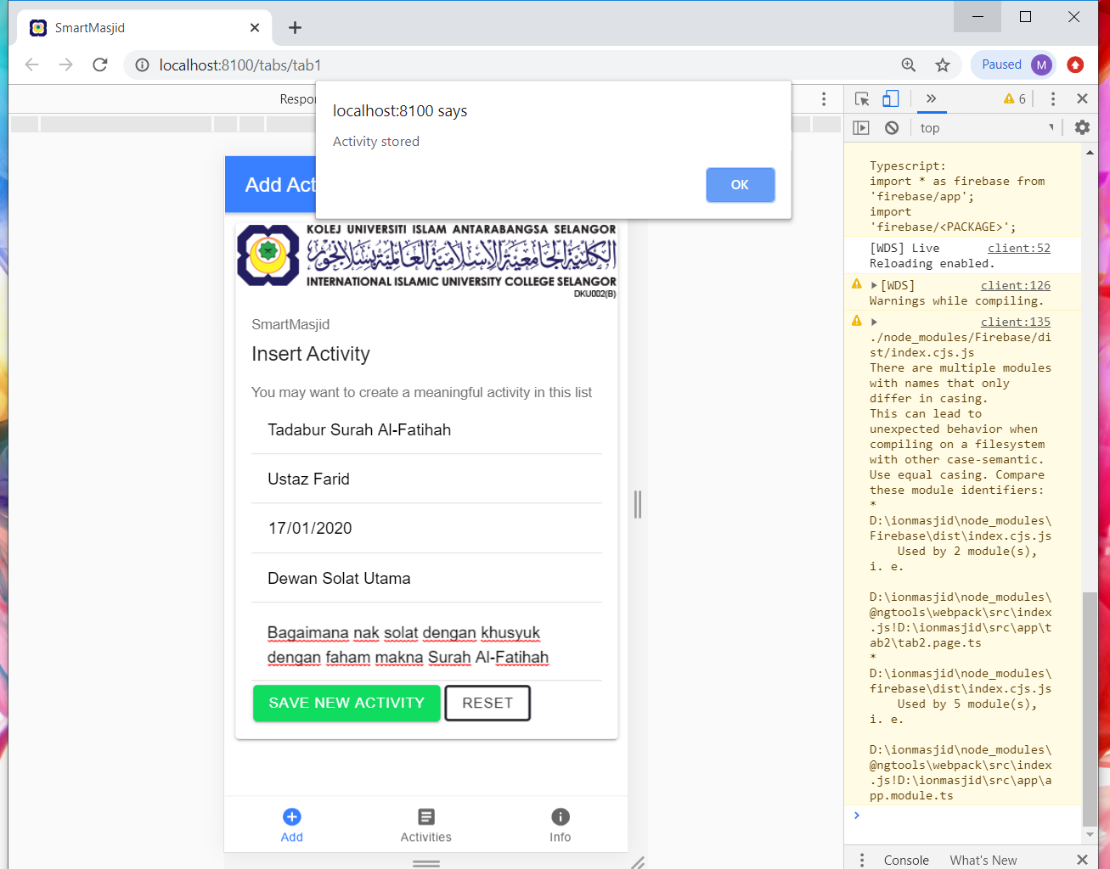
IONIC : to test, run ionic serve

Slide 29
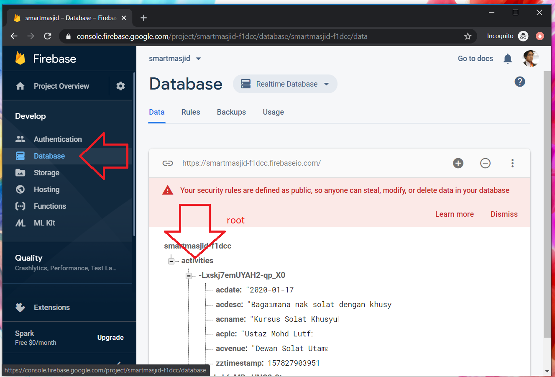
FIREBASE : to view records

Slide 30
Complete code GITHUB
https://github.com/khirulnizam/ionmasjid

